Slide 1
Holmstad Library Kiosk

Slide 2
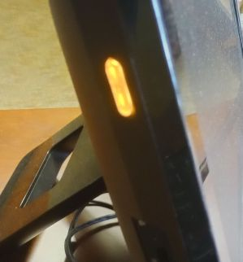
Power Button
The Power Button is on the left side.
If it is not lit the computer is powered off.
If the button is amber the computer is in a standby or sleep state. Moving the mouse or pushing a keyboard button should wake up the PC.
If the button is blue The computer is powered on and functioning normally.
* The PC is slow so patience is required to wait for the PC to complete powering up.

Slide 3
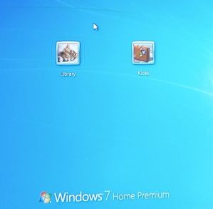
Logging On
After The PC is powered on you will be shown a logon screen. Select the icon labeled Kiosk.

Slide 4
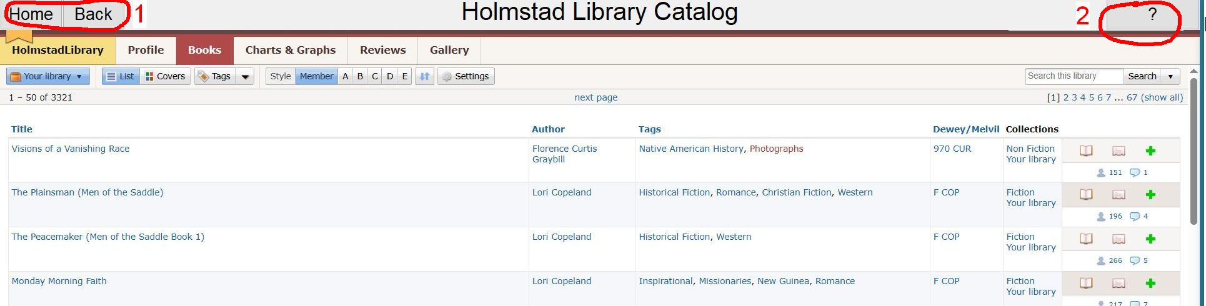
Kiosk Screen
You will be presented with the "LibraryThing" web site.
The Home button (1) will take you back to this screen at any time.
Clicking on "Back" button (1) button takes you to the previous screen.
The "?" button (2) will present this help document.

Slide 5
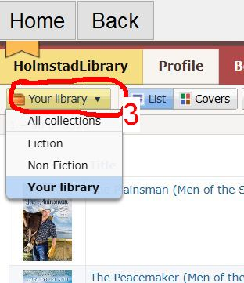
Collections
A Search can be made of "All Collections", only "Fiction" or only "Non-Fiction". Use the "Your Library" pull down (3) to choose the collection.

Slide 6
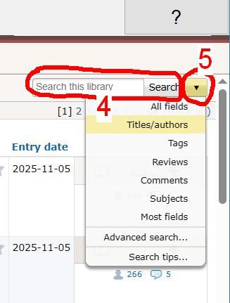
Search Overview
Type your search word(s), (for example author name or title) in the search box (4) (labeled "Search this library") on the top right of the screen. Then use the mouse to click on the word "Search" (4).
Use the search drop down (5) to limit your search to specific fields.
The "Advanced search" and "Search tips” options will give instruction on how to do more in-depth searches.

Slide 7
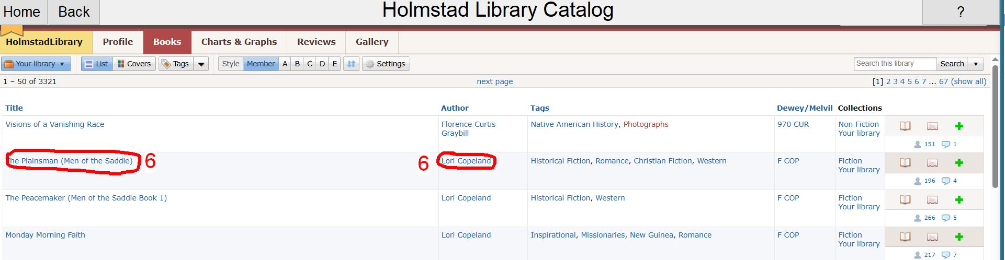
Viewing
Clicking on any item (6) in a column will give more information about that item.
Clicking on an authors name will give information about the author.
Clicking on a book title will give more information about the book.

